Slide 1
FOCL Algorithm
- By M. Shiva Laxmi Vara Prasad
21AG1A1233

Slide 2
What is FOCL ?
Def: The First Order Combined Learner (FOCL) Algorithm is an extension of the purely inductive, FOIL Algorithm. It uses domain theory to further improve the search for the best-rule and greatly improves accuracy. It incorporates the methods of Explanation-Based learning (EBL) into the existing methods of FOIL.
FOCL algorithm is an important concept in machine learning, used for pattern recognition and data classification.

Slide 3
Importance of FOCL ?
Improved Efficiency
Enhanced Accuracy
Increased Interpretability
Applicability to Diverse Domains
Integration with Other Learning Techniques
Notes:
Importance of FOCL Algorithm in Machine Learning:
The FOCL algorithm offers several advantages over its predecessor, FOIL, making it valuable in the field of machine learning. Here are some of its key strengths:
1. Improved Efficiency:
FOCL leverages domain knowledge to focus its search for rules, leading to faster convergence and reduced training time. This is particularly beneficial when dealing with large datasets or when computational resources are limited.
2. Enhanced Accuracy:
By incorporating prior knowledge, FOCL can identify more relevant features and generate rules that more accurately capture the underlying relationships in the data. This can lead to improved prediction performance compared to purely inductive algorithms like FOIL.
3. Increased Interpretability:
The use of domain knowledge in FOCL helps to make the generated rules more human-readable and understandable. This allows us to gain insights into the reasoning behind the model's predictions, which can be crucial in certain applications.
4. Applicability to Diverse Domains:
FOCL's ability to integrate domain knowledge makes it adaptable to various domains where prior knowledge exists. This includes fields like healthcare, finance, and natural language processing, where specific domain rules can significantly improve learning outcomes.
5. Integration with Other Learning Techniques:
FOCL can be combined with other machine learning techniques, such as neural networks, to create hybrid models. This can leverage the strengths of each approach, resulting in more powerful and flexible learning systems.

Slide 4
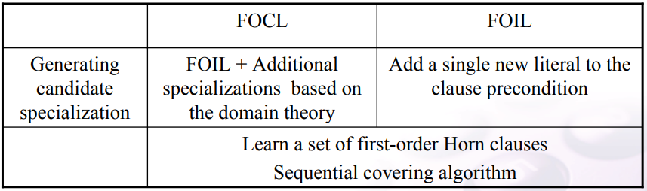
FOCL Vs FOIL
Using prior knowledge to augment search operators
Extension of the purely FOIL

Slide 5
Type of literals
Operational
If a literal is allowed to be used in describing an output hypothesis
Non operational
If a literal occur only as intermediate features in the domain theory

Slide 6
Working of FOCL algorithm
Select one of the domain theory clause
Remove non operational / unnecessary literals
Pure the pre-condition of h unless puring reduces classification accuracy over training data

Slide 7
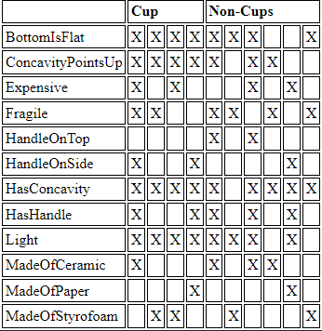
Training Example

Slide 8
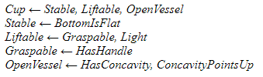
Domain theory

Slide 9
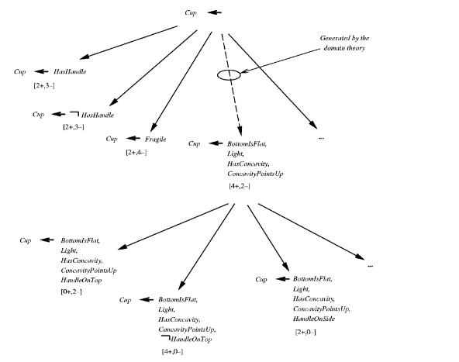

Slide 10
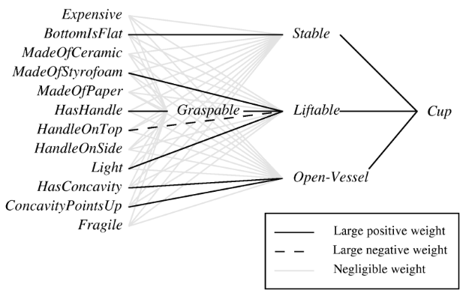
After Training

Slide 11
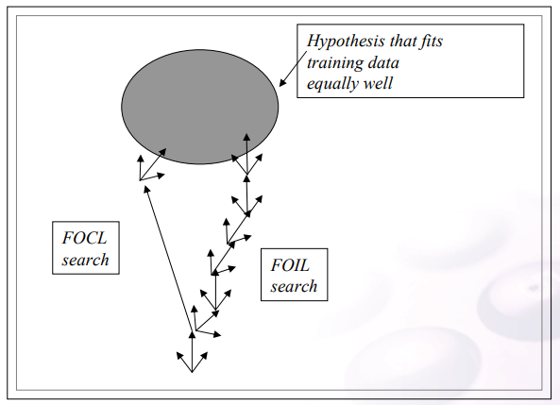
Hypothesis space

Slide 12



Remarks
Horn clause of the form
: An initial conjunction of operational literals (added one at
time by the first syntactic operator)
: A conjunction of operational literals (added in a single step based on the domain theory)
: A final conjunction of operational literals (added one at a
time by the first syntactic operator)

Slide 13


Slide 14


